Slide 1
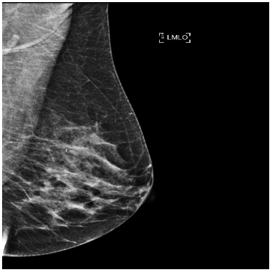
Assessment of Breast Density Using Unsupervised Variational Autoencoders
Su Kara
Cheryl Johnson
Capistrano Valley HS

Slide 2
Abstract
About 1 in 8 U.S. women will develop breast cancer in their lifetime. Breast density is a strong indicator for breast cancer. Women with extremely dense breasts have a sixfold greater risk of developing breast cancer. This study proposes a fully unsupervised deep learning algorithm for the calculation of breast density. A variational autoencoder algorithm was trained on 6,987 mammograms of 734 UCI patients without any manual annotations of the dense regions of the breast. Ground-truth ratios of fibroglandular tissue to breast were generated by using U-Net segmentation on 3D MRIs of the same patients. Pearson correlation between the mean of the cleaned up latent feature matrix and the ground-truth ratios was calculated as 0.68 to show a linear relationship. With the use of the encoder model portion of the variational autoencoder, I was able to predict the breast density as the ratio of the fibroglandular tissue to the whole breast accurately.

Slide 3
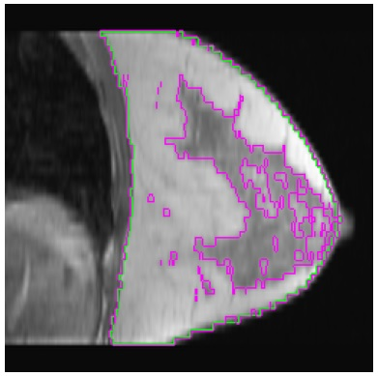
Problem
Breast density is about how much fibro-glandular tissue there is in a breast.
MRI shows breast density clearly, but it’s expensive and time consuming.
Image annotation for supervised algorithms requires the time of radiologists.
How does an unsupervised deep-learning algorithm predict breast density?

Slide 4
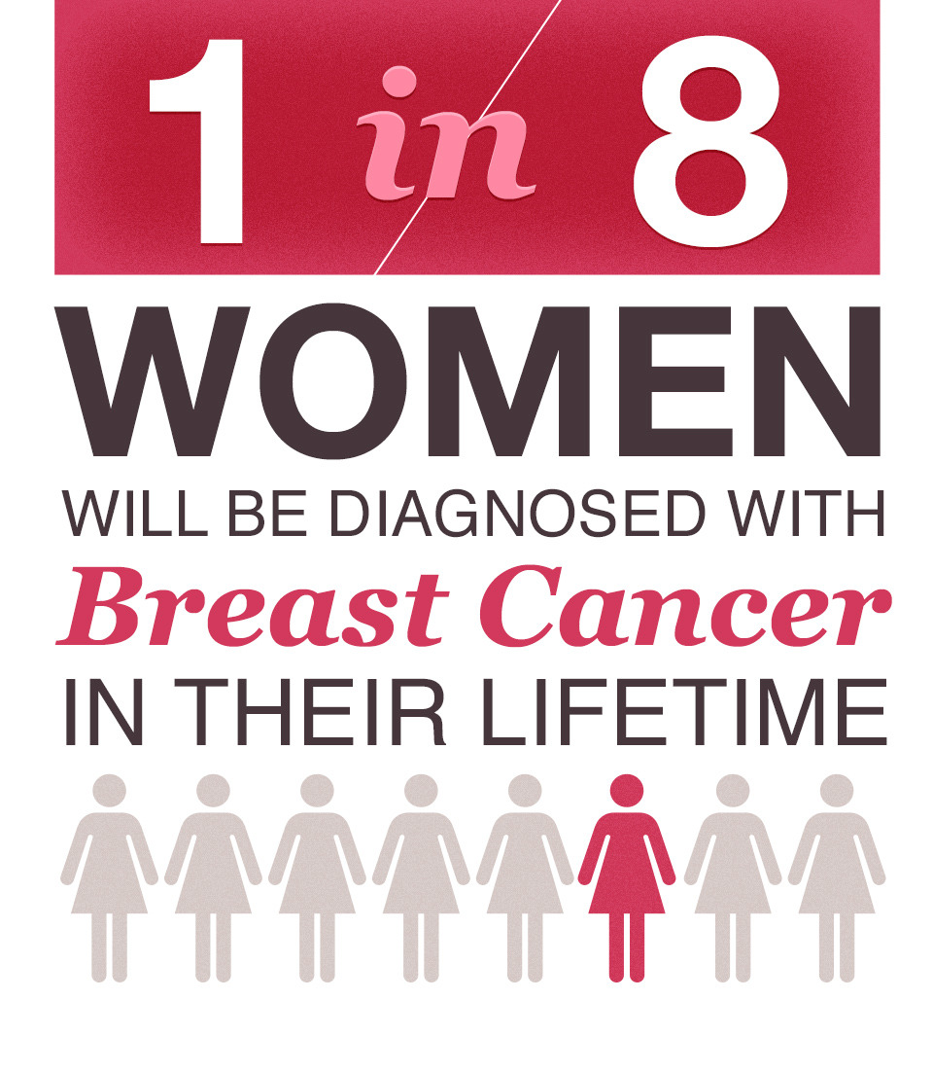
Introduction (Background Research)
1 in 8 U.S. women develops breast cancer over the course of their lifetime (Breastcancer.org, 2021).
Women with extremely dense breasts have a sixfold greater risk of developing breast cancer (Mandelson, 2000).
There are 4 categories of breast density: fatty, scattered, heterogeneous, and dense (Mayo Clinic Staff, 2020).
Accuracy could be improved with a ratio of the fibro glandular tissue to the whole breast.
Speed could be improved by using a deep learning algorithm.
Cost could be minimized by avoiding the need for additional and expensive procedures such as MRI and ultrasound for less dense breasts.
Courtesy of United Cancer Support Foundation

Slide 5
Hypothesis
Variational Autoencoder (VAE) is an unsupervised deep-learning algorithm (Jordan, 2018).
VAE can be trained on mammograms with no annotations of breast or fibro-glandular tissue (FGT) segmentation.
VAE doesn’t require the supervision of FGT/breast ratio as a number either.
If VAE is trained on mammograms with no annotations, then it will predict breast density as the ratio of FGT to breast.

Slide 6
Materials
Python 3.6, TensorFlow 2.1.0, Keras 1.0.8
10 GeForce RTX Titan servers at the UCI lab
734 patient images:
734 3D MRIs (128x256x256)
6,987 2D mammograms (512x512)
Patch shape of 32x32 and latent dimension from 1 to 10
VAE Architecture
mean vector
latent matrix
16x16
input image
512x512
encoder
std dev
vector
decoder
output image
512x512
sampler

Slide 7

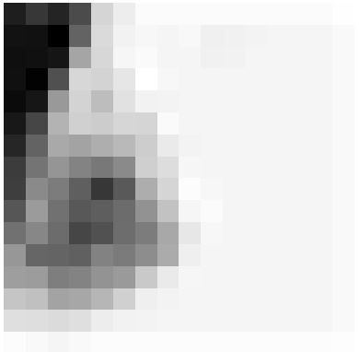
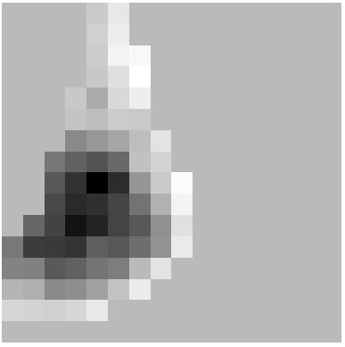
Procedure
Train U-Net (Ronneberger, 2015) to generate FGT/breast ratios on MRIs (Zhang, 2019) and to mask pectoralis on mammograms (Moreira, 2012)
Train VAE and run encoder prediction on a 512x512 input mammogram
Generate a 16x16 latent feature matrix for a patch shape of 32x32
Clean up latent feature matrix by applying the pectoralis mask
Collapse masked latent matrix into a single value such as mean
Correlate them with the FGT/breast ratios from U-Net on MRIs
original image
latent matrix
masked latent

Slide 8
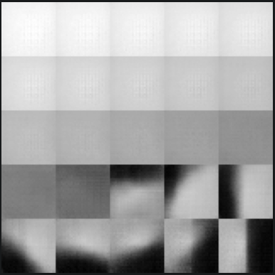
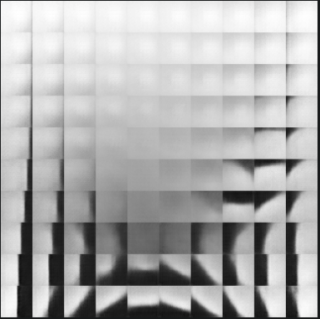
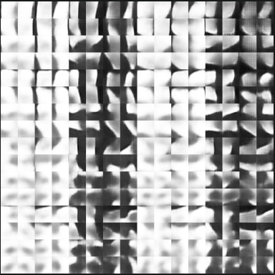
Results
Decoder Predictions for Different Latent Dimensions
1 feature
2 features
8 features

Slide 9
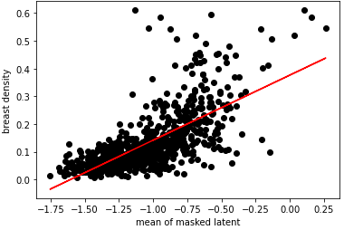
Results (continued)
Top 5 Performers
Latent Dimension | Parameter | Pearson Correlation
10 | mean | 0.68
9 | mean | 0.67
8 | mean | 0.67
10 | mean | 0.66
10 | 75th percentile | 0.66
Linear Regression
MAE: 0.05
Correlation: 0.68
y = 0.23x + 0.38

Slide 10
Discussion
Mean absolute error of 0.05 and Pearson correlation of 0.68 give confidence to the unsupervised VAE algorithm.
There is a linear relationship with the mean of masked latent and breast density, which can be converted to a formula such as y = 0.23x + 0.38.
Even though decoder predictions show a clearer distinction between FGT and breast in lower number of features, somehow higher latent dimensions result in higher correlation. The model must be learning more about contrast in those additional features.
There are similar medical applications such as supervised convolutional neural networks to assess breast density from mammograms. However, they’re either doing binary classifications such as dense or not dense (Lehman, 2018), or multi-class classification such as fatty, scattered, heterogeneous, or dense (Mohamed, 2018).

Slide 11
Conclusion
The data supports my hypothesis that an unsupervised deep learning algorithm such as VAE can be used to predict breast density. Even though supervised algorithms such as regular CNN and U-Net models still provide higher accuracy, radiologists need to spend a lot of time to annotate MRIs, CT scans, and mammograms manually. Unsupervised techniques will be the next breakthrough in the use of AI in medical diagnosis as there will be no need to annotate images anymore. This study proves that new unsupervised techniques can be used to address some of the current medical diagnosis needs.

Slide 12
Reflection/Application
I learned about unsupervised algorithms and how powerful they could be as a deep learning tool by speeding up the training process.
The performance could be further improved with higher latent dimensions to learn more features. Similarly, it could be trained and tested with different patch shapes, which will directly affect the latent matrix size and resolution.
Radiologists can start using this solution to measure breast density without any manual annotations or segmentations.
This study can also serve as a general framework for researchers who plan to use unsupervised deep learning solutions in other domains including image processing and medical diagnosis.

Slide 13
References Cited
Breastcancer.org. (2021, February 04). U.S. breast cancer statistics. Retrieved February 19, 2021, from https://www.breastcancer.org/symptoms/understand_bc/statistics
Jordan, J. (2018, March 19). Variational autoencoders. Retrieved February 19, 2021, from https://www.jeremyjordan.me/variational-autoencoders/
Lehman, C., Yala, A., Schuster, T., Dontchos, B., Bahl, M., Swanson, K., & Barzilay, R. (2018, October 16). Mammographic breast density assessment using deep learning: clinical implementation. Radiology 2019; 290:52–58. https://doi.org/10.1148/radiol.2018180694
Mandelson, M., Oestreicher, N., Porter, P., White, D., Finder, C., Taplin, S., & White, E. (2000, July 05). Breast density as a predictor of mammographic detection: comparison of interval- and screen-detected cancers. JNCI: Journal of the National Cancer Institute, Volume 92, Issue 13, 5 July 2000, Pages 1081–1087. https://doi.org/10.1093/jnci/92.13.1081
Mayo Clinic Staff. (2020, February 18). Dense breast tissue may increase the risk of breast cancer. Retrieved February 19, 2021, from https://www.mayoclinic.org/tests-procedures/mammogram/in-depth/dense-breast-tissue/art-20123968
Mohamed, A.A., Berg, W.A., Peng, H., Luo, Y., Jankowitz, R.C., & Wu, S. (2018, January). A deep learning method for classifying mammographic breast density categories. Med Phys. 2018 Jan;45(1):314-321. https://doi.org/10.1002/mp.12683
Moreira, I.C., Amaral, I., Domingues, I., Cardoso, A., Cardoso, M.J., & Cardoso, J.S. (2012, February). INbreast: toward a full-field digital mammographic database. Acad Radiol. 2012 Feb;19(2):236-48. doi: 10.1016/j.acra.2011.09.014. Epub 2011 Nov 10. PMID: 22078258

Slide 14
References Cited (continued)
Ronneberger, O., Fischer, P., & Brox, T. (2015, May 18). U-Net: Convolutional networks for biomedical image segmentation. Retrieved February 19, 2021, from https://arxiv.org/abs/1505.04597
Zhang Y., Chen, J.H., Chang, K.T., Park, V.Y., Kim, M.J., Chan, S., Chang, P., Chow, D., Luk, A., Kwong, T., & Su, M.Y. (2019, January 31). Automatic Breast and Fibroglandular Tissue Segmentation in Breast MRI Using Deep Learning by a Fully-Convolutional Residual Neural Network U-Net. Acad Radiol. 2019;26(11):1526-1535. doi:10.1016/j.acra.2019.01.012

